Slide 1
Intercultural Education The Answer to Cultural Diversity in the Classroom
22. – 28. 07. 2017
Limassol

Slide 2
MARINA, MARINA …

Slide 3
THEN & NOW

Slide 4
Sailing through the AGES…

Slide 5
Singing in the SUN…

Slide 6
LOVE is in the air https://www.youtube.com/watch?v=NNC0kIzM1Fo

Slide 7
The BEAUTY of ageing…

Slide 8
GRACES in the Sun

Slide 9
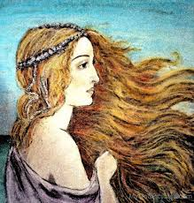
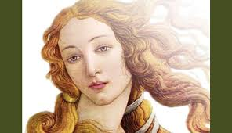
APHRODITES’ hiking…

Slide 10
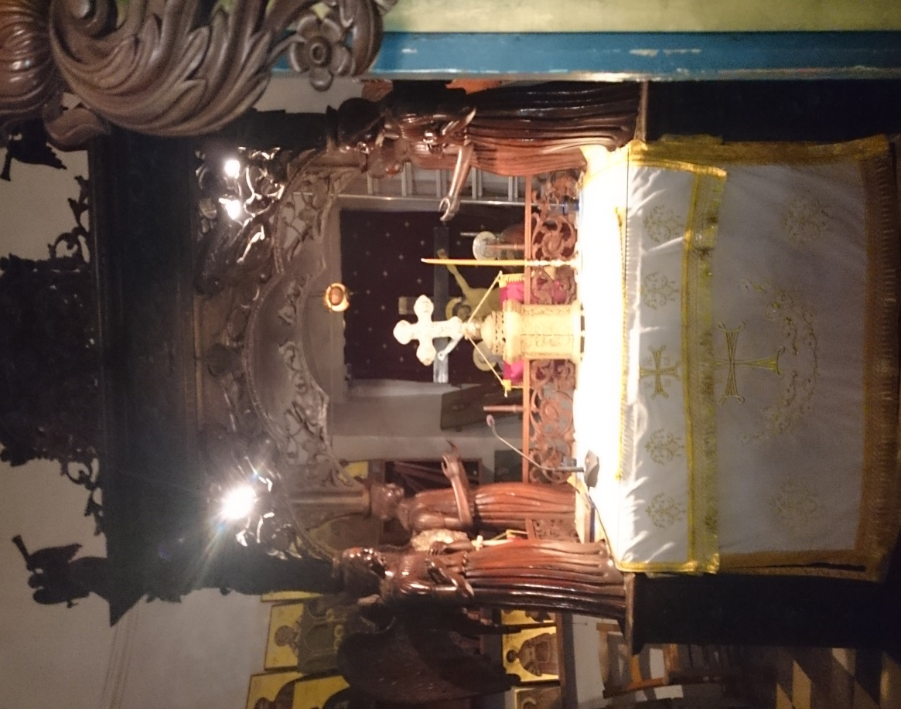
Living in HARMONY

Slide 11
VARIETY is beautiful…

Slide 12
Through green eyes…

Slide 13
Thank you for your attention

